Slide 1
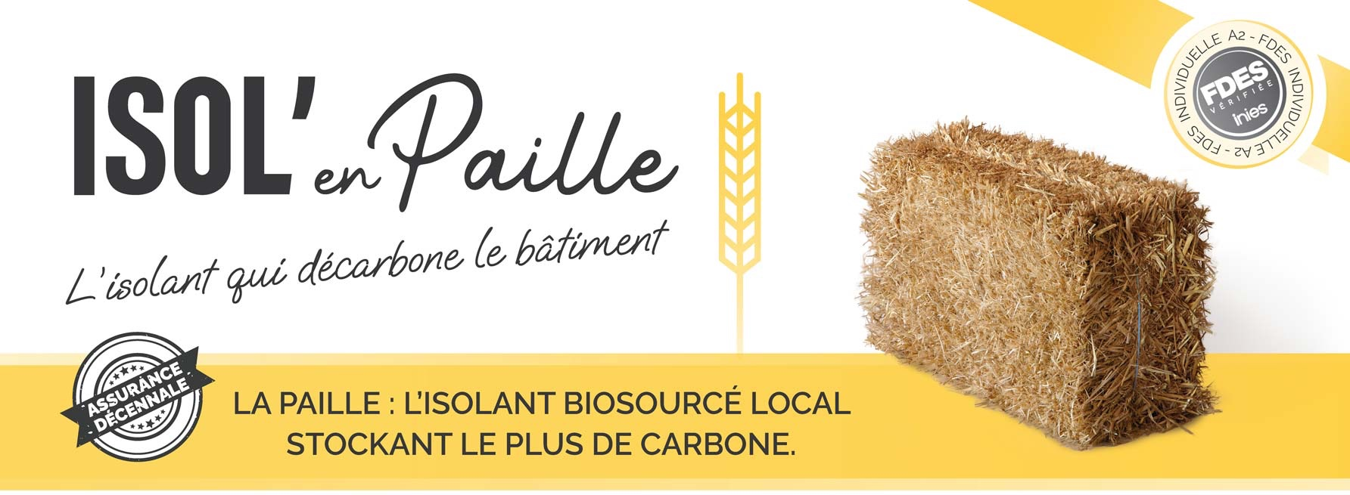
INSUL with Straw
Decarbonize Real Estate
The Environment :
The Habitat :
The Economy :
Biobased / Stores Carbon !
Winter & Summer Comfort
Resources & local employment
GOOD FOR

Slide 2
My name is
Isol’en Paille products have benefited from all the expertise of Nicolaas Oudhof, a committed engineer and trainer, specializing in ecological construction.
Developing straw bales insulation are the result of his unique experience and his desire to democratize straw insulation by making construction sites faster and more competitive.

Slide 3
Today, many buildings are insulated like that in France
New or Renovated…

Slide 4
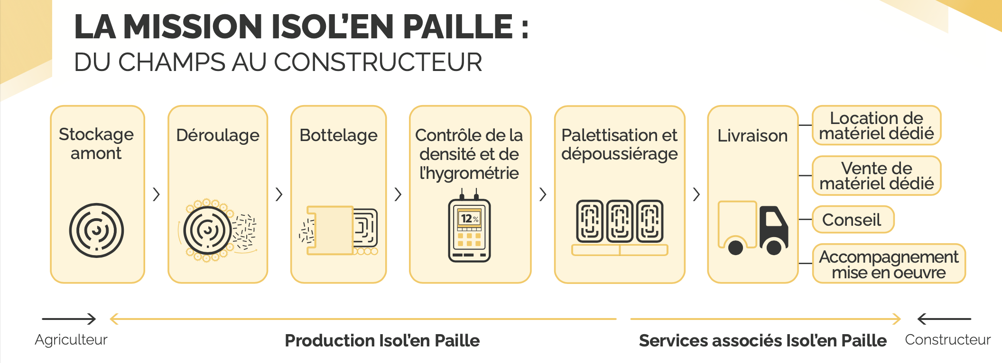
The Factory is near Angers (49)
The production process of insulation is all about logistics

Slide 5
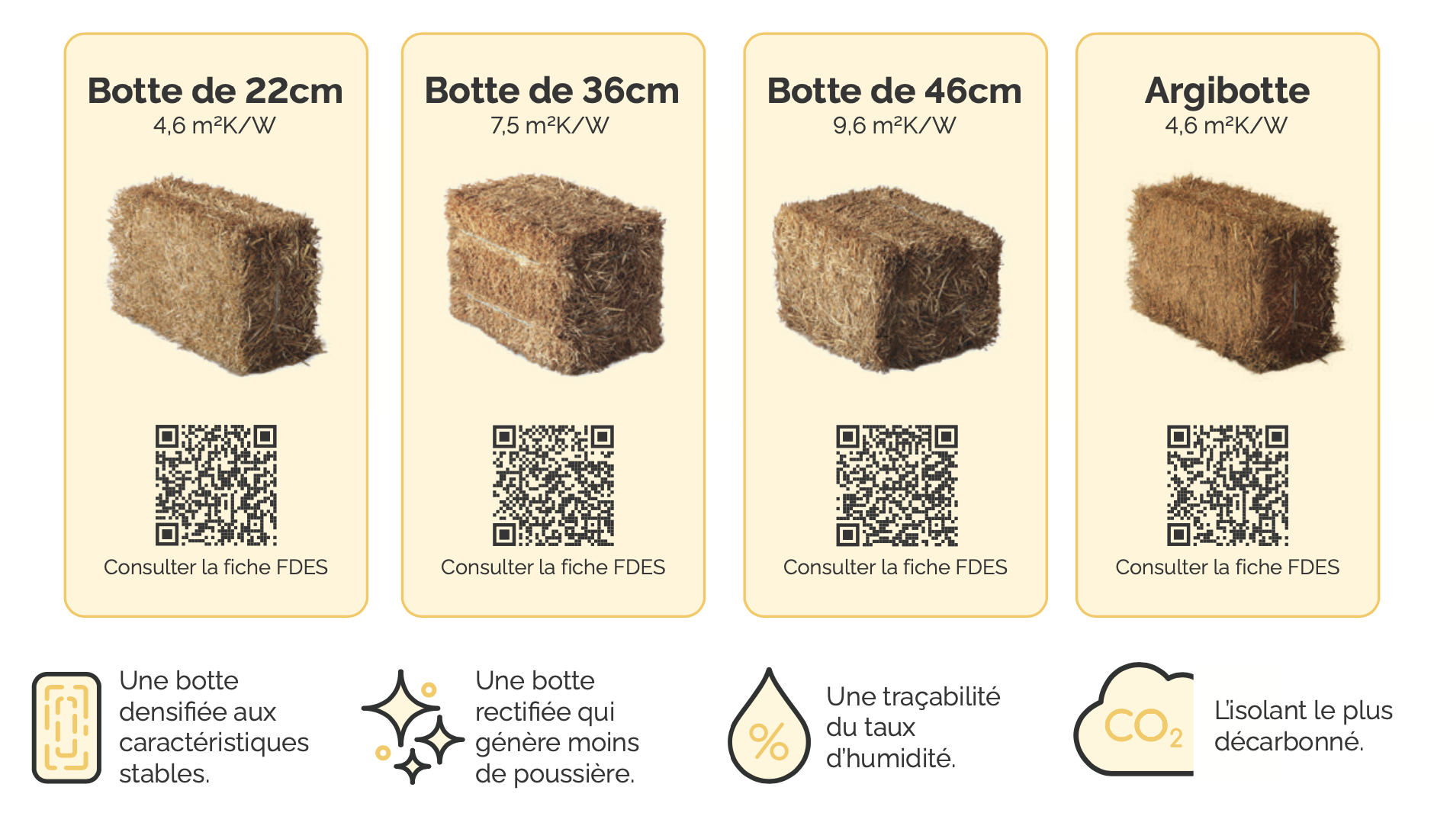
A complete range of ready-to-use straw insulation blocs
Every products have an environmental impact certification

Slide 6
One of the ways of using straw is in timber frames

Slide 7
In France, this has developed thanks to favorable regulations and a strong network

Slide 8
The straw insulation sector has secured government funding to encourage its even wider use
R&D budget:
€7,000,000/5 years

Slide 9
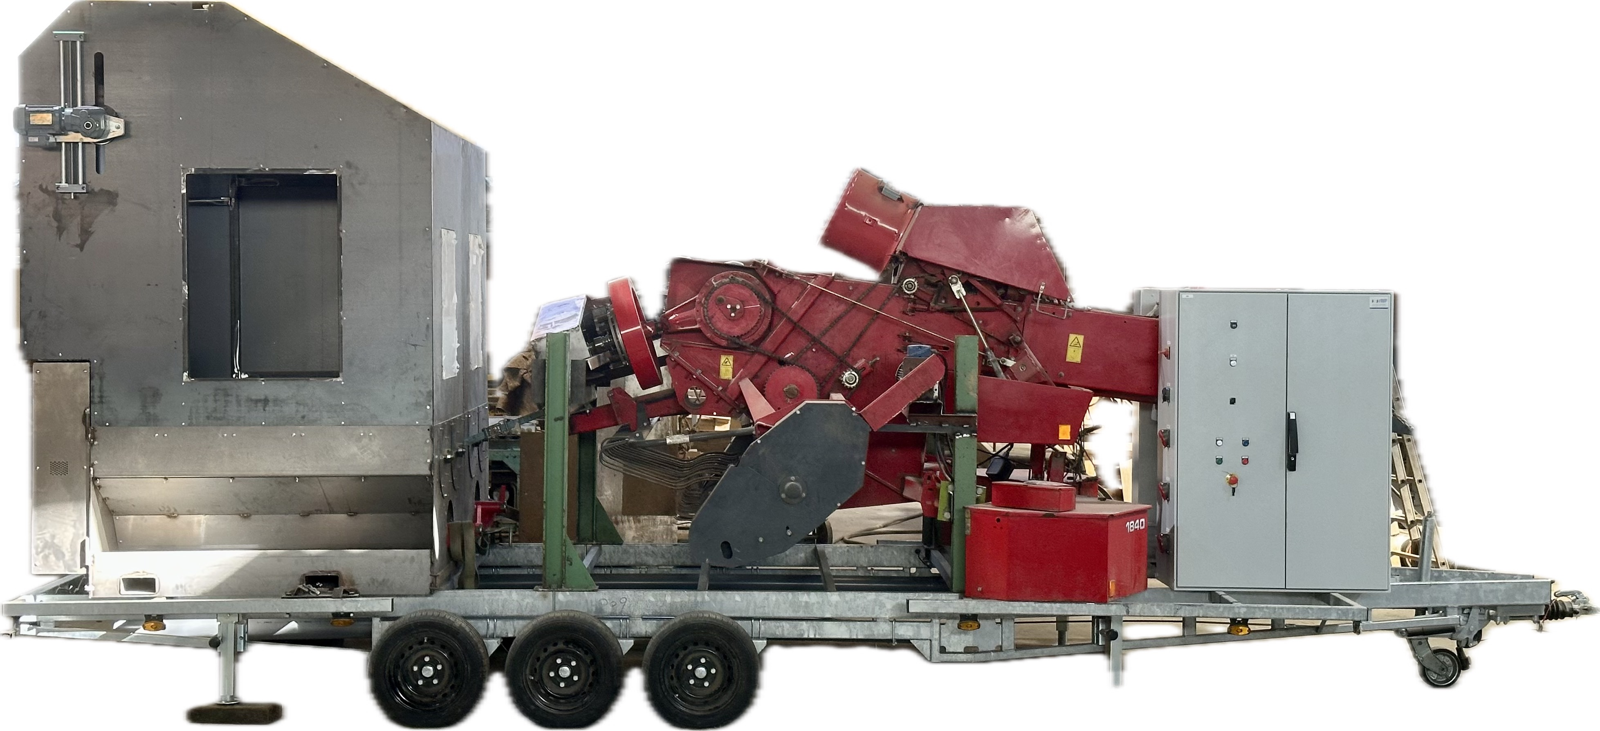
…a mobile factory was prototyped so that products are always produced locally !
and for the circular economy loop to be complete…

Slide 10
PRESS your Straw
BRINGING STRAW PRODUCTION CLOSER TO THE RESOURCE

Slide 11
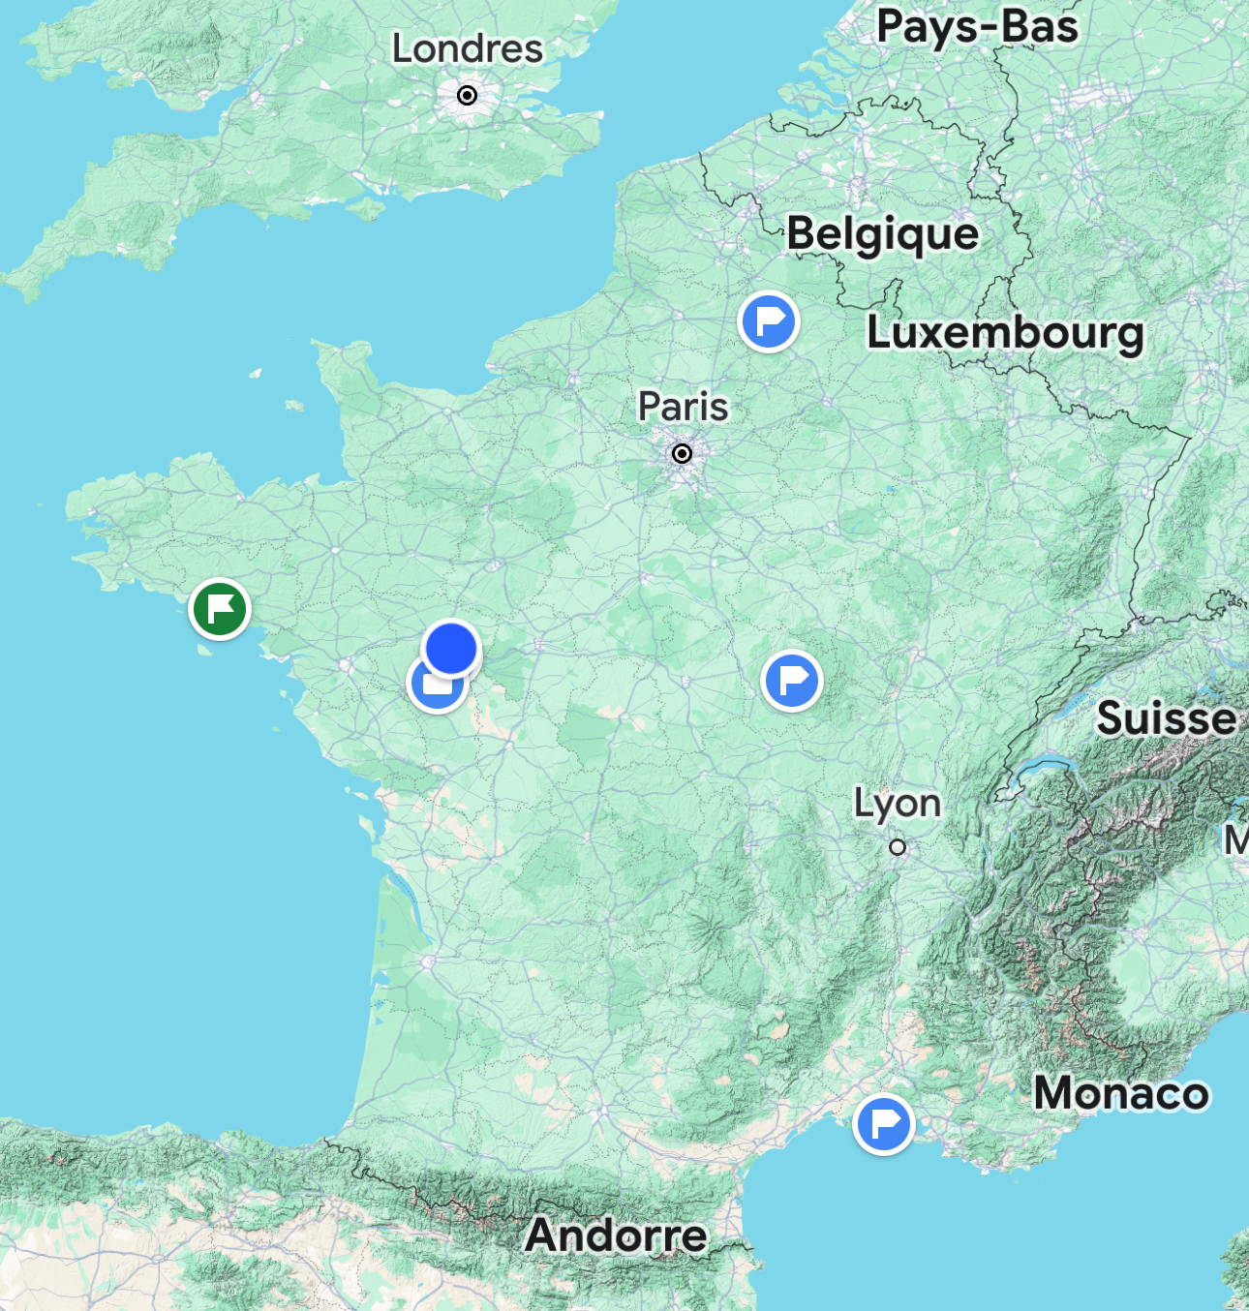
A franchise of the ISOL’en Paille concept which has already found several production sites and Europe soon !
Bretagne
Nord
Nièvre
Camargue

Slide 12
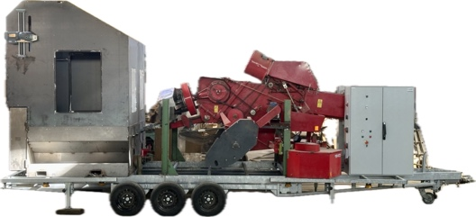
A fundraiser is underway
For the manufacture of 6x Mobile Factories
Levée
Pré-amorçage
Juil 24
Janv 25
Juil 25
Janv 26
Juil 26
Janv 27
Cumulative turnover target of 4M€

Slide 13
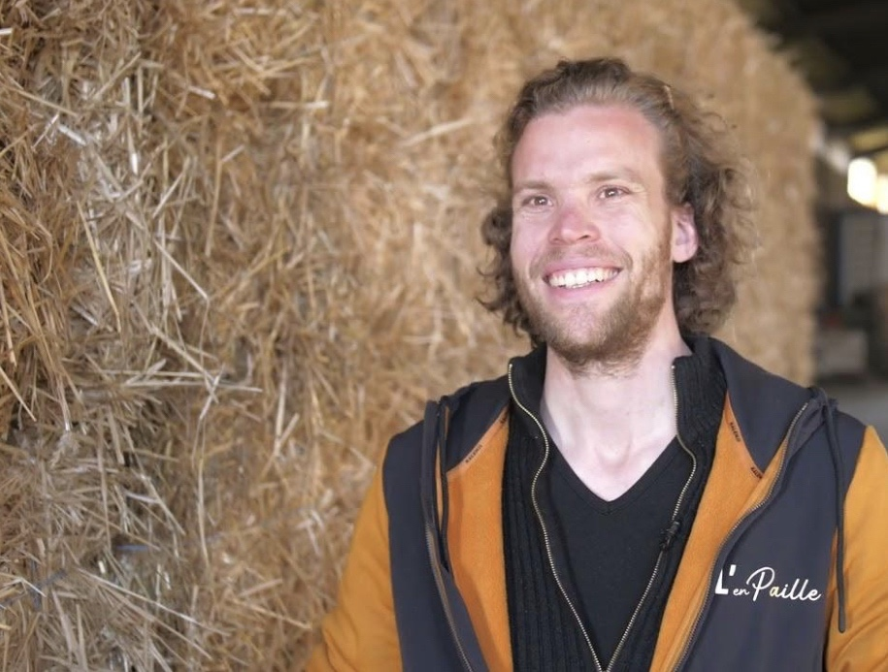
They trusted me
Watch ULI Video here :
https://youtu.be/eOzBfOcs_DI

